Slide 1
Lecture 29
Matched pairs; categories

Slide 2
Review
1 What does $df=min(n_{1}−1,n_{2}−1)$ approximate?
the Welch df that software uses: a smaller df, so a conservative P-value
2 When do we pool for two means?
only when $σ_{1}=σ_{2}$ is reasonable (similar SDs); unpooled is our default
3 What is the pooled SD $s_{p}$?
one SD from both samples: $s_{p}^{2}=\left((n_{1}−1)s_{1}^{2}+(n_{2}−1)s_{2}^{2}\right)/\left(n_{1}+n_{2}−2\right)$

Slide 3
The rank-sum test (non-parametric)
Wilcoxon rank-sum test
compares two independent samples without assuming normal populations
how it works
rank all $n_{1}+n_{2}$ values together, then compare the two samples' rank sums
when to use it
small samples from skewed populations, outliers, or ranked (ordinal) data
more
Resources → Extras → Non-parametric Tests (also the signed-rank test for pairs)

Slide 4
Matched pairs: the idea
matched pairs
each value in one sample is paired with one in the other: same subject twice
the differences
$d=x_{1}−x_{2}$ for each pair: the $n$ differences are the data
the parameter
$μ_{d}$: the mean difference in the population of pairs
the big idea
a two-sample design becomes a one-sample t-test on the differences

Slide 5
The matched-pairs t-test
$$H_{0}:μ_{d}=0$$
no difference within pairs, on average
$$H_{A}$$
$μ_{d}>0$ (upper), $μ_{d}<0$ (lower), $μ_{d}≠0$ (two-sided)
the test statistic
$t_{obs}=\left(\overline{d}−0\right)/\left(s_{d}/\sqrt{n}\right)$: $\overline{d},s_{d}$ = the mean and SD of the differences
degrees of freedom
$df=n−1$, where $n$ is the number of pairs
assumptions
a random sample of pairs; the differences are normal, or $n≥30$

Slide 6
Data: hypnotism and pain
Subject | A | B | C | D | E | F | G | H
Before | 6.6 | 6.5 | 9.0 | 10.3 | 11.3 | 8.1 | 6.3 | 11.6
After | 6.8 | 2.4 | 7.4 | 8.5 | 8.1 | 6.1 | 3.4 | 2.0
d = after − before | 0.2 | −4.1 | −1.6 | −1.8 | −3.2 | −2.0 | −2.9 | −9.6
Randomly selected subjects had a sensory pain score measured before and after hypnotism; a lower score means less pain. $X$ = a subject’s score before, $Y$ = the same subject’s score after, $d=Y−X$. $n=8$ pairs. (OpenStax, Example 10.11)

Slide 7
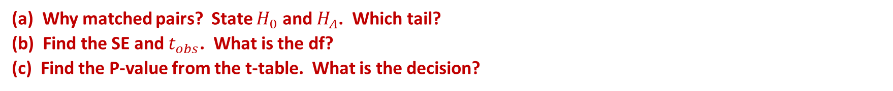
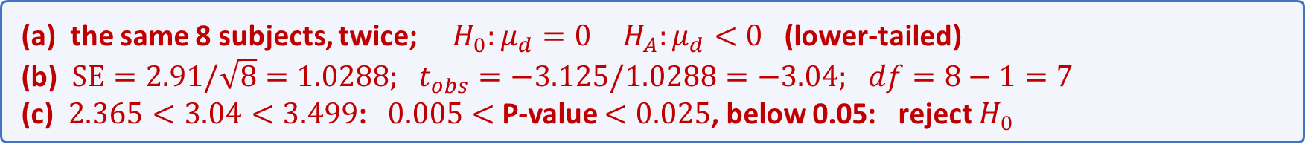
Example: does hypnotism reduce pain?
A study asked whether hypnotism reduces pain. Each subject’s pain score was measured before and after hypnotism (lower means less pain), and the differences are normal. Are the scores lower after hypnotism, on average? (OpenStax, Example 10.11)
$n=8$ subjects; $d$ = after − before; $\overline{d}=−3.125, s_{d}=2.91$; $α=0.05$
(a) Why matched pairs? State $H_{0}$ and $H_{A}$. Which tail?
(b) Find the SE and $t_{obs}$. What is the df?
(c) Find the P-value from the t-table. What is the decision?
(a) the same 8 subjects, twice; $H_{0}:μ_{d}=0 H_{A}:μ_{d}<0$ (lower-tailed)
(b) $SE=2.91/\sqrt{8}=1.0288; t_{obs}=−3.125/1.0288=−3.04; df=8−1=7$
(c) $2.365<3.04<3.499$: $0.005<$ P-value $<0.025$, below 0.05: reject $H_{0}$

Slide 8
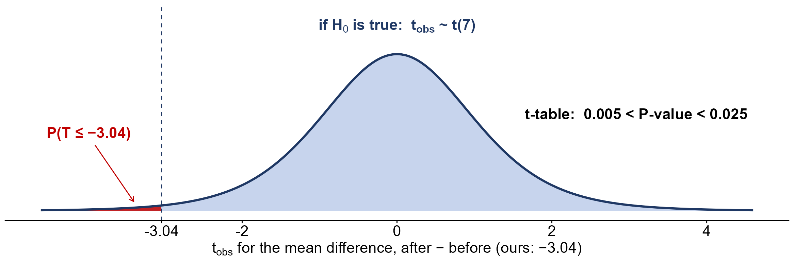
The hypnotism P-value
$0.005<$ P-value $<0.025$ (software: 0.0094): pain scores are lower after hypnotism, on average

Slide 9
Why pair?
Suppose we forgot the pairing and treated the hypnotism scores as two independent samples of 8.
before: $\overline{x}=8.71, s=2.18$; after: $\overline{x}=5.59, s=2.61$; ${\overline{x}}_{after}−{\overline{x}}_{before}=−3.125$
(a) Find the unpooled SE and $t_{obs}$.
(b) Compare with the matched-pairs test. Why is the paired SE smaller?
(a) $SE=\sqrt{{2.18}^{2}/8+{2.61}^{2}/8}=1.2023; t_{obs}=−3.125/1.2023=−2.60$
(b) paired $SE=1.0288<1.2023$: each subject is their own control

Slide 10
Data: shot-put with each hand
Student | 1 | 2 | 3 | 4 | 5 | 6 | 7
Dominant hand | 30 | 26 | 34 | 17 | 19 | 26 | 20
Weaker hand | 28 | 14 | 27 | 18 | 17 | 26 | 16
d = dominant − weaker | 2 | 12 | 7 | −1 | 2 | 0 | 4
Seven eighth graders pushed the shot-put with their dominant (writing) hand and with their weaker hand, in feet. $X$ = the dominant-hand distance, $Y$ = the weaker-hand distance, $d=X−Y$. $n=7$ pairs. (OpenStax, Example 10.13)

Slide 11
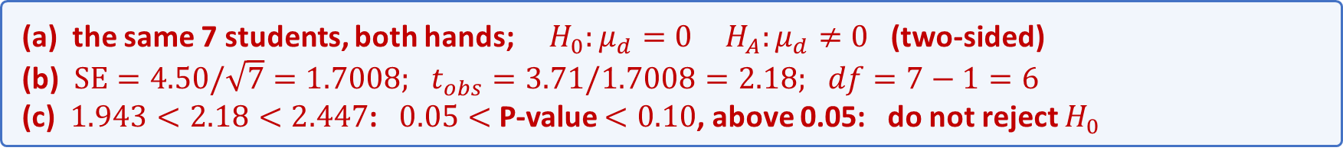
Practice: shot-put with each hand
Seven eighth graders thought they could push the shot-put equal distances with either hand. Each pushed with their dominant hand and with their weaker hand; the differences are normal. Is there a mean difference between the two hands? (OpenStax, Example 10.13)
$n=7$ students; $d$ = dominant − weaker (feet); $\overline{d}=3.71, s_{d}=4.50$; $α=0.05$
(a) Why matched pairs? State $H_{0}$ and $H_{A}$. Which tail?
(b) Find the SE and $t_{obs}$. What is the df?
(c) Find the P-value from the t-table. What is the decision?
(a) the same 7 students, both hands; $H_{0}:μ_{d}=0 H_{A}:μ_{d}≠0$ (two-sided)
(b) $SE=4.50/\sqrt{7}=1.7008; t_{obs}=3.71/1.7008=2.18; df=7−1=6$
(c) $1.943<2.18<2.447$: $0.05<$ P-value $<0.10$, above 0.05: do not reject $H_{0}$

Slide 12
Practice: which test?
1 Mean nightly sleep: random samples of 40 first-years and 40 seniors
two independent samples t-test: two separate samples, a quantitative response
2 Reaction time of 25 drivers, rested and after a sleepless night
matched-pairs t-test: the same 25 drivers, measured twice
3 Share who exercise daily: random samples of 200 dog and 200 cat owners
two-proportion z-test: two independent samples, a yes/no response

Slide 13
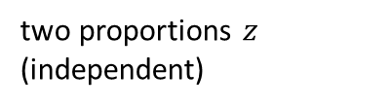




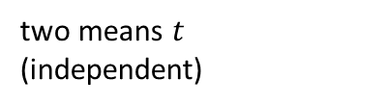

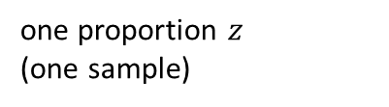
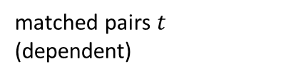

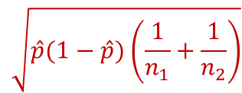
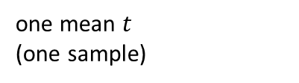
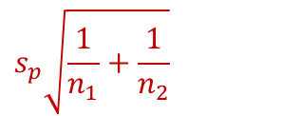
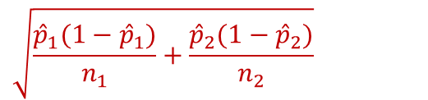
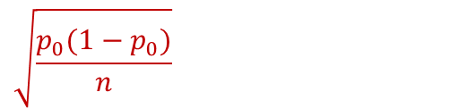

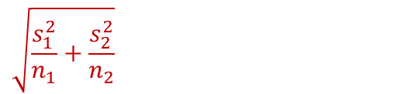
Summary: every test so far
test (samples)
test statistic
SE, unpooled
SE, pooled
one proportion $z$
(one sample)
$$z_{obs}=\frac{\hat{p}−p_{0}}{SE}$$
$$\sqrt{\frac{p_{0}(1−p_{0})}{n}}$$
—
one mean $t$
(one sample)
$$t_{obs}=\frac{\overline{x}−μ_{0}}{SE}$$
$$\frac{s}{\sqrt{n}}$$
—
two proportions $z$
(independent)
$$z_{obs}=\frac{({\hat{p}}_{1}−{\hat{p}}_{2})−d_{0}}{SE}$$
$$\sqrt{\frac{{\hat{p}}_{1}(1−{\hat{p}}_{1})}{n_{1}}+\frac{{\hat{p}}_{2}(1−{\hat{p}}_{2})}{n_{2}}}$$
$$\sqrt{\hat{p}(1−\hat{p})\left(\frac{1}{n_{1}}+\frac{1}{n_{2}}\right)}$$
two means $t$
(independent)
$$t_{obs}=\frac{{\overline{x}}_{1}−{\overline{x}}_{2}}{SE}$$
$$\sqrt{\frac{s_{1}^{2}}{n_{1}}+\frac{s_{2}^{2}}{n_{2}}}$$
$$s_{p}\sqrt{\frac{1}{n_{1}}+\frac{1}{n_{2}}}$$
matched pairs $t$
(dependent)
$$t_{obs}=\frac{\overline{d}−0}{SE}$$
$$\frac{s_{d}}{\sqrt{n}}$$
—
pool only for $H_{0}:p_{1}=p_{2}$, or when $σ_{1}=σ_{2}$ is reasonable. Non-parametric: the sign test (pairs), the rank-sum test (independent)

Slide 14
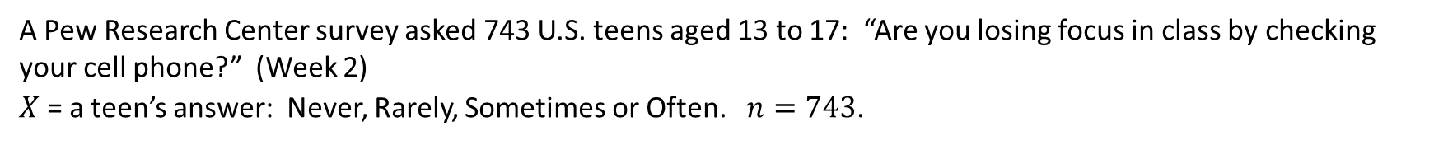
Data: teens and phones
Answer | Never | Rarely | Sometimes | Often | Total
Count | 289 | 216 | 178 | 60 | 743
Proportion | 0.39 | 0.29 | 0.24 | 0.08 | 1.00
A Pew Research Center survey asked 743 U.S. teens aged 13 to 17: “Are you losing focus in class by checking your cell phone?” (Week 2)
$X$ = a teen’s answer: Never, Rarely, Sometimes or Often. $n=743$.

Slide 15
More than two categories?
So far a categorical response had two outcomes (yes or no), and we tested one $p$ or $p_{1}−p_{2}$. The Pew question has four answers, and someone claims all four are equally common among U.S. teens.
Never 289, Rarely 216, Sometimes 178, Often 60; $n=743$
(a) What kind of variable is $X$? How many categories does it have?
(b) Can a test of one proportion $p$ check the claim? Why or why not?
(a) categorical, with $k=4$ categories
(b) no: one $p$ covers one category; the claim is about all four, $p_{1},p_{2},p_{3},p_{4}$, at once

Slide 16
Tables for categorical data
one-way table
the count in each category of one categorical variable
two-way (contingency) table
the count for every combination of two categorical variables: rows × columns
marginal distribution
one variable on its own: the row or column totals, as proportions
conditional distribution
one variable within a single row (or column) of the other, as proportions

Slide 17
Data: volunteers and hours
Type of volunteer | 1–3 hours | 4–6 hours | 7–9 hours | Row total
Community college | 111 | 96 | 48 | 255
Four-year college | 96 | 133 | 61 | 290
Nonstudents | 91 | 150 | 53 | 294
Column total | 298 | 379 | 162 | 839
Adults 21 and older volunteer one to nine hours a week with a disabled senior citizen. A sample of 839 volunteers: $X$ = type of volunteer, $Y$ = hours volunteered per week. (OpenStax, Example 11.6)

Slide 18
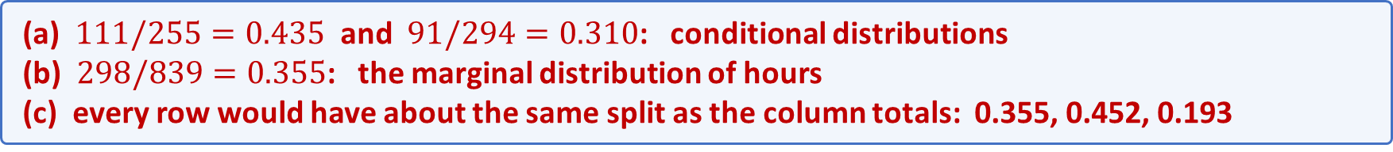
Example: do the rows look alike?
Is the number of hours volunteered related to the type of volunteer? Before any test, compare the rows of the two-way table.
1–3 hours: community college 111 of 255; nonstudents 91 of 294; everyone 298 of 839
(a) What share of community college volunteers work 1–3 hours? Of nonstudents?
(b) What share of all 839 volunteers work 1–3 hours? Which kind of distribution is each?
(c) If hours had nothing to do with type, what would the rows look like?
(a) $111/255=0.435$ and $91/294=0.310$: conditional distributions
(b) $298/839=0.355$: the marginal distribution of hours
(c) every row would have about the same split as the column totals: 0.355, 0.452, 0.193

Slide 19
Observed and expected counts
observed count $O$
the count in a category (or cell) of our data
expected count $E$
the count we would expect if $H_{0}$ is true: $E=n p_{i}$, with $p_{i}$ from $H_{0}$
the chi-square distribution
a family of right-skewed curves for values $≥0$, one for each df
degrees of freedom (one variable)
$df=k−1$, where $k$ is the number of categories

Slide 20
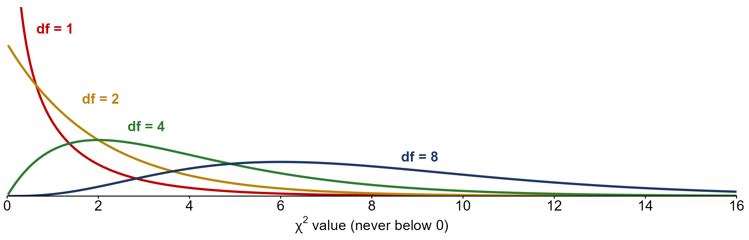
The chi-square distribution
never below 0, skewed right; mean $=df$; a larger df moves the curve right

Slide 21
The chi-square statistic
the chi-square statistic
$$X^{2}=∑\frac{(O−E)^{2}}{E}$$
added up over every category: how far each count is from what $H_{0}$ predicts
$$X^{2}=0$$
the observed counts match $H_{0}$ exactly
a large $X^{2}$
the counts are far from $H_{0}$: evidence against $H_{0}$ (always right-tailed)
if $H_{0}$ is true
$X^{2}$ is approximately $χ^{2}(k−1)$, when every $E≥5$

Slide 22
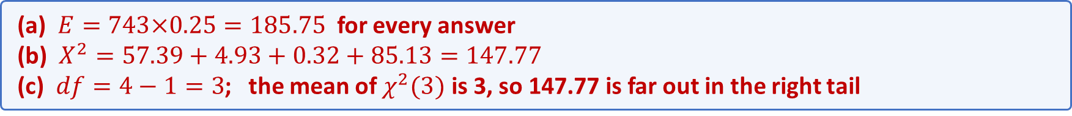
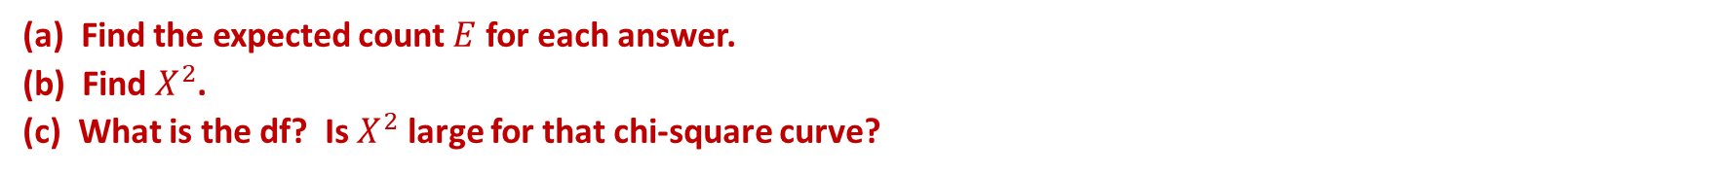
Example: equally common answers?
Back to the Pew survey. Someone claims the four answers are equally common among U.S. teens:
$$H_{0}:p_{1}=p_{2}=p_{3}=p_{4}=0.25$$
$n=743$; observed: Never 289, Rarely 216, Sometimes 178, Often 60
(a) Find the expected count $E$ for each answer.
(b) Find $X^{2}$.
(c) What is the df? Is $X^{2}$ large for that chi-square curve?
(a) $E=743×0.25=185.75$ for every answer
(b) $X^{2}=57.39+4.93+0.32+85.13=147.77$
(c) $df=4−1=3$; the mean of $χ^{2}(3)$ is 3, so 147.77 is far out in the right tail

